Slide 1
Applied Physics(C. Sc.) BS CS Semester-I Course Code: L-9(laws of thermodynamics and the human body.) IUB & All Affiliated Colleges. Reality Awards Boost Up (YT-Channel)
Rushmat Ali
Assistant Professor OF Physics
Govt. Kh. F. Graduate College R. Y. Khan

Slide 2
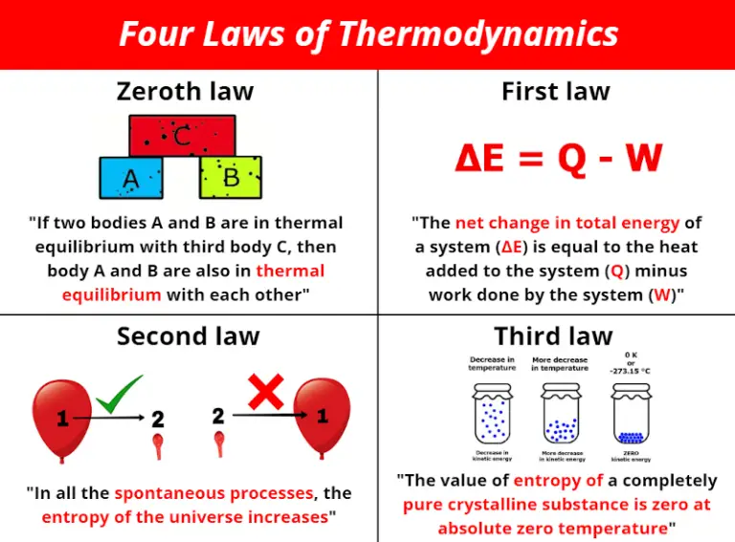
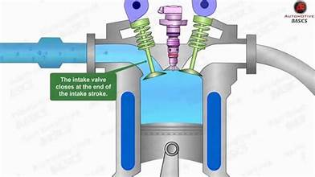
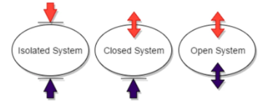
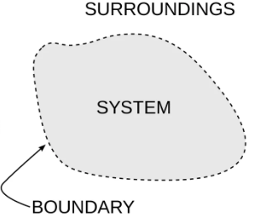
Thermo-dynamics:
Laws of Thermo
0th Law
1sT Law
2nd Law
3rd Law
Thermodynamics: It is originated from 2 words
Therm means Heat and Dynamics means in Motion:
It means that Heat in Motion OR motion due to heat.
The study of heat and conversion of heat into other forms of energy specially the mechanical energy and vice versa, is called thermodynamics.
The device used for conversion of heat into mechanical engine is called heat engine.
Heat engine and all the thermodynamical processes work under specific set of laws, called laws of thermodynamics.
The general principles under which conversion of heat into mechanical energy takes place are called laws of Thermodynamics.
There are 4 laws of thermodynamics.
Zeroth Law(It defines temperature)
First Law( Law of conservation of energy)
Second Law(Heat Engine/Refrigerator)
Third Law(Entropy Existence)

Slide 3
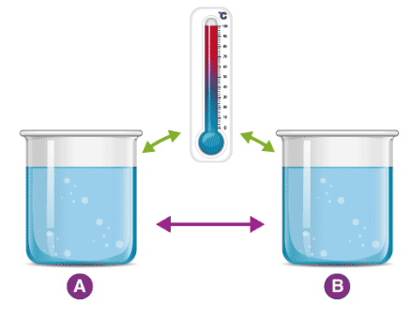
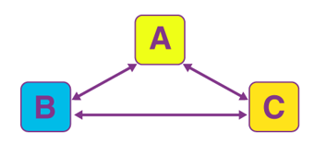
Zeroth Law
The term "zeroth law" was coined, in 1871 Maxwell
The Zeroth law of thermodynamics states that if two bodies are individually in equilibrium with a separate third body, then the first two bodies are also in thermal equilibrium with each other.
The zeroth law of thermodynamics is one of the four laws of thermodynamics, which states that if two systems are in thermal equilibrium with a third system, then they are in thermal equilibrium with one another.
Thermodynamics is the study of the relationship between heat, temperature, work, and energy.Most generally, equilibrium refers to a balanced state that does not change overall with time.
Thermal equilibrium refers to the situation where two objects that can transfer heat to each other stay at a constant temperature over time.
Applications :
The zeroth law of thermodynamics is seen in many everyday situations.
The thermometer may be the most well-known example of the zeroth law in action. Say the thermostat in bedroom reads 67 F. This means that thermostat is in thermal equilibrium with bedroom.
If we place a package of meat in freezer and leave it overnight, the meat has reached the same temperature as the freezer and the other items in the freezer.

Slide 4
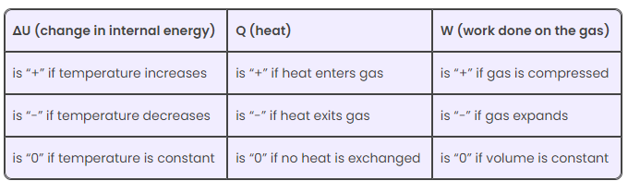
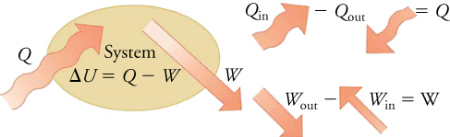
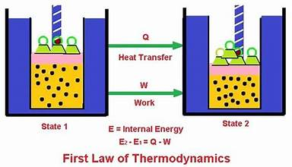
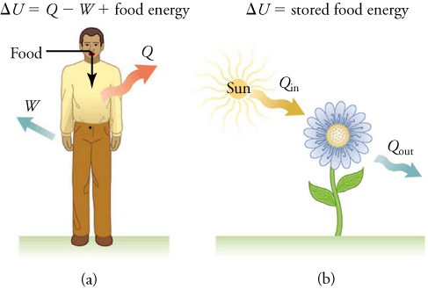

1st Law Of Thermodynamics
It is the law of conservation of energy in thermodynamics.
It states that “Energy can neither be created nor destroyed, but it can be changed from one form to another”
Within an isolated system, the total energy of the system is constant, even if energy has been converted from one form to another.
Statement: In any thermodynamical, when heat is added to a system, It appears as an increase in internal energy plus work done by the system on the surrounding”
Mathematically, $∆Q=U∆+∆W$ OR Q = $∆U+W.$
Examples: Thermodynamics can be applied to living systems, such as our own bodies. This forms the basis of the biological thermodynamics.
Human metabolism is the conversion of food into energy given off by heat, work done by the body’s cells, and stored fat.
Metabolism is an interesting example of the first law of thermodynamics in action. Eating increases the internal energy of the body by adding chemical potential energy.

Slide 5
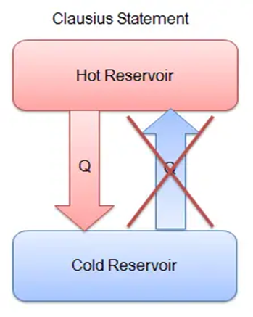
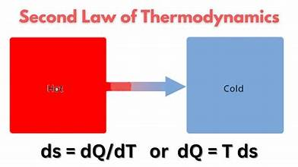
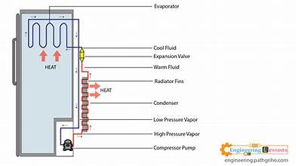
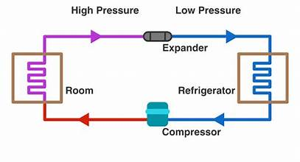
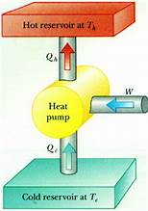
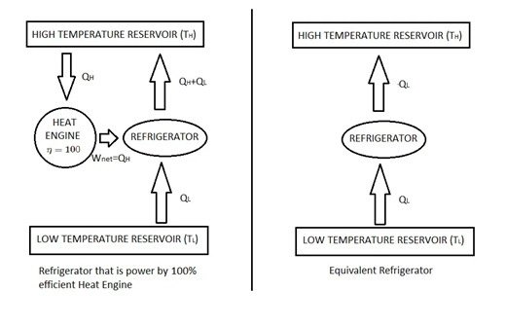

second Law of Thermodynamics:
The law which describes the direction of heat flow. It tells us how heat energy can be converted into useful work done
Statement: There are different ways by which second law of thermos can be stated.
1.Kelvin’s Statement:
“It is impossible to devise a process that takes heat from high temperature reservoir and convert whole of it into useful work done with out leaving any change in the working substance”
Explanation: No one heat engine is present which is ideal. Real engines are
Petrol Engine: It has efficiency of 25%-30%. Diesel Engine: It has efficiency of 35 % - 40 %
Someone may think that efficiency is decreasing due to heat rejected towards sink. If the sink is removed from engine, Q2=0, …… can we think of increased efficiency? It is not possible.
2. Clausius Statement:
In a cyclic process, it is impossible to make heat flow from low temperature to a high temperature without expenditure of external work done. It is about the refrigerator.
Explanation: When a hot body and cold body are placed in contact with each other, heat flows from high temperature to a low temperature in a natural way. In case of refrigerator, heat flows from low temperature to high temperature. But it is due to expenditure of external electrical energy. The compressor of refrigerator is motor that runs with electricity. Refrigerator is a Heat Pump. Because it makes heat flow cold body to hot body
If Q1 is heat of cold body at low temperature and Q2 is the temperature of Hot body, such that Q1 > Q2, then Q1-Q2 is the amount of heat made flow from low to high temperature. External work energy must be supplied=W = Q1 –Q2.
Basically both statements are equivalent. In general, Mathematically, dS =$\frac{dQ}{T}$

Slide 6
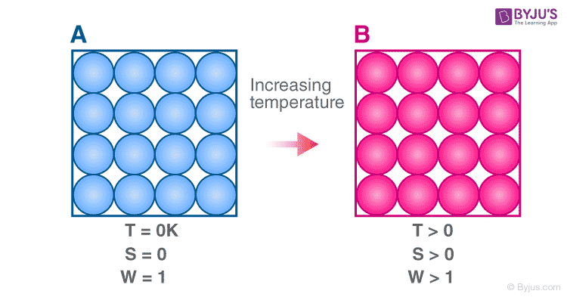
Third Law of thermodynamics:
The third law of thermodynamics states that the entropy of a closed system at thermodynamic equilibrium approaches a constant value when its temperature approaches absolute zero. The Nernst statement of the third law of thermodynamics concerns thermodynamic processes at a fixed, low temperature:
Statement: The entropy of a pure solid or liquid at absolute zero of temperature is zero.
Proof: By the Ist and IInd law of thermodynamics: T dS = dU + P dV (1)
Let f, U and S be the Free energy, Internal energy and Entropy Functions per gram mole of a substance. Then f = U –T S (2)
Differentiating it: df = d (U – T S )
= dU – T dS – S dT = dU – dU – P dV – S dT => df = - P dV – S dT (3)
This relations shows that f is a function of V and T i. e. f = f( V , T)
df = (𝝏𝒇/𝝏𝑽)T dV + (𝝏𝒇/𝝏𝑻)V dT (4)
Comparing equations (3) and (4) term by term by term:
( 𝝏𝒇/𝝏𝑽)T = - P & ( 𝝏𝒇/𝝏𝑻)V = - S
Putting the value of –S in equation (2)
f = U + T (𝝏𝒇/𝝏𝑻)V (5)
Plank proved that as T = 0, function f and U themselves becomes equal i.e.
(𝐥𝐢𝐦)(𝑻 => 𝟎)⁡〖𝒇(𝑻) 〗= (𝐥𝐢𝐦)(𝑻 => 𝟎)⁡〖𝒇(𝑼) so, f = U as T => 0
By equation (2) (𝝏𝒇/𝝏𝑻)V = (𝒇 −𝑼)/𝑻 => (𝐥𝐢𝐦)(𝑻 => 𝟎) ⁡〖( 𝝏𝒇/𝝏𝑻〗)V = (𝐥𝐢𝐦)(𝑻 => 𝟎) ⁡〖 (𝒇 −𝑼)/(𝑻 ) = (𝐥𝐢𝐦)(𝑻=> 𝟎)⁡〖 ( 𝑼 −𝑼)/𝑻〗 = 0
=> (𝒍𝒊𝒎 )(𝑻 => 𝟎) ⁡〖 (−𝑺)=0
=> (𝐥𝐢𝐦)( 𝑻 => 𝟎) ⁡𝑺 = 0, Which is the required proof.

Slide 7
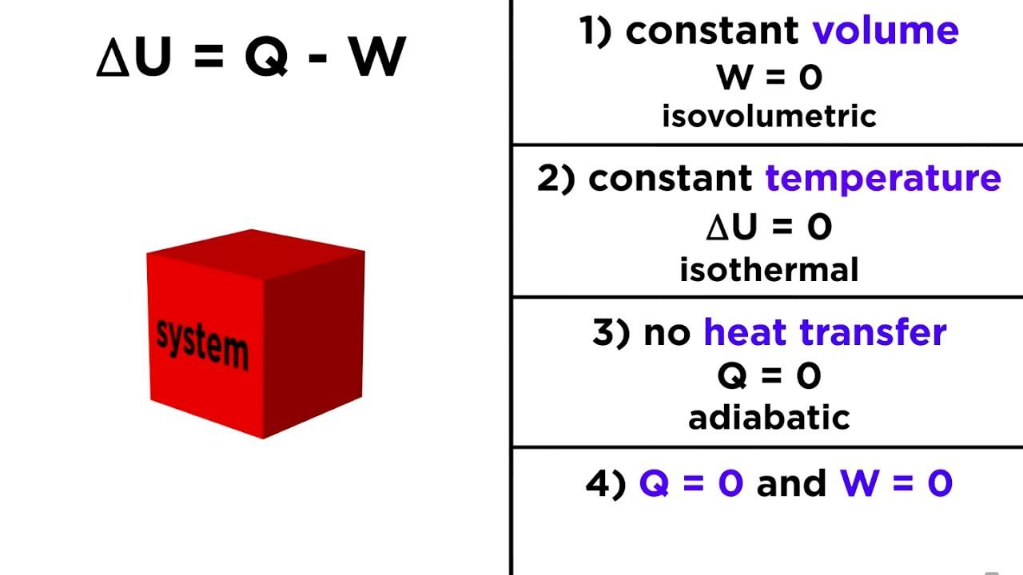
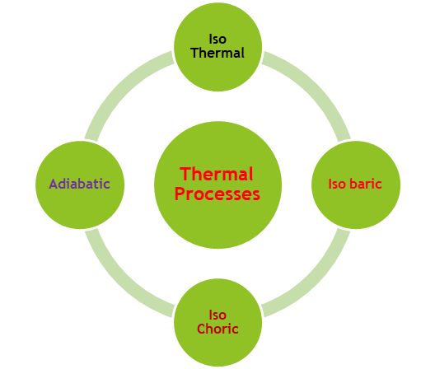
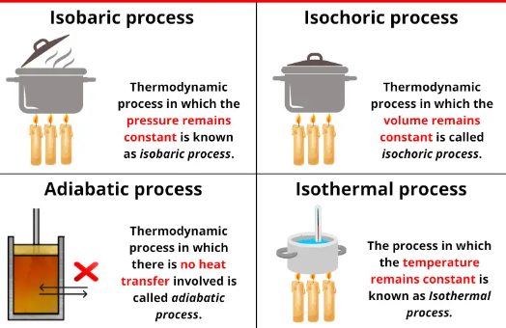
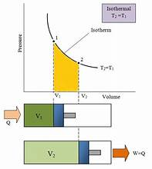
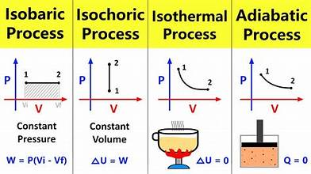
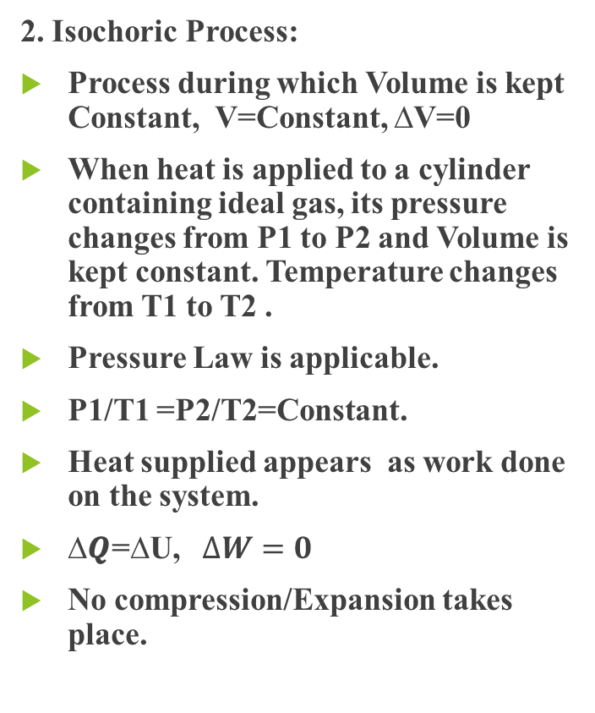

Thermo-dynamic Process:
1. Isothermal Process:
Process during which Temperature is kept Constant, T=Constant, $∆T$=0
When heat is applied to a cylinder containing ideal gas, its pressure changes from P1 to P2 and Volume changes from V1 to V2 keeping temperature constant.
Boyle’s Law is applicable.
P1V1 =P2V2=Constant.
Heat supplied appears as work done on the system.
$∆Q=∆W$
Slow compression/Expansion is an example.
2. Isochoric Process:
Process during which Volume is kept Constant, V=Constant, ∆V=0
When heat is applied to a cylinder containing ideal gas, its pressure changes from P1 to P2 and Volume is kept constant. Temperature changes from T1 to T2 .
Pressure Law is applicable.
P1/T1 =P2/T2=Constant.
Heat supplied appears as work done on the system.
∆𝑸=∆U, $∆W=0$
No compression/Expansion takes place.

Slide 8
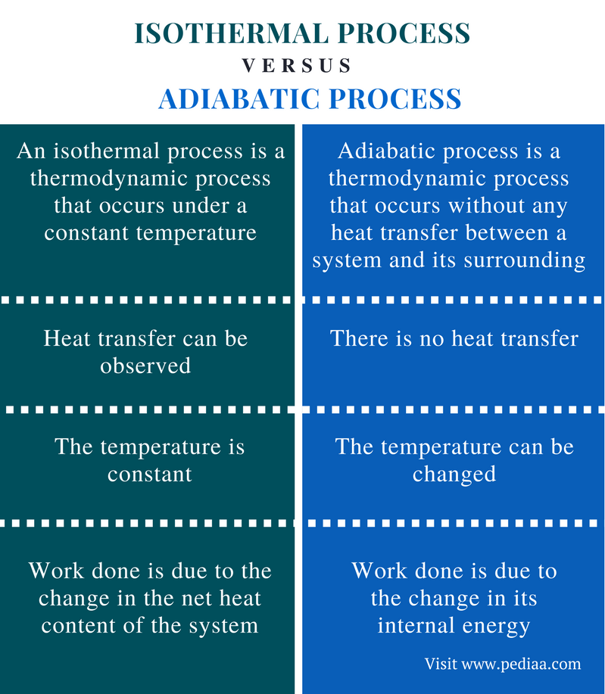
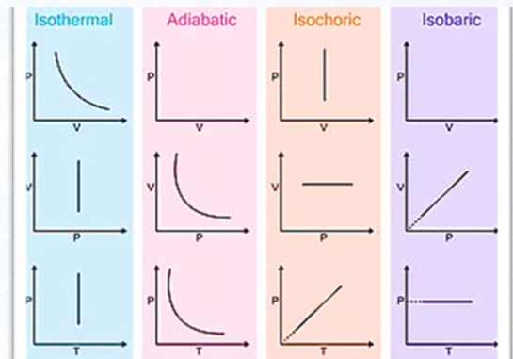

Thermo-dynamic Process:
3. Isobaric Process:
Process during which Pressure is kept Constant, P=Constant, ∆P=0
When heat is applied to a cylinder containing ideal gas, its Temperature changes from T1 to T2 and Volume changes from V1 to V2 keeping pressure constant.
Charles’s Law is applicable.
V1/T1 =V2/T2=Constant.
Heat supplied appears as work done on the system.
∆𝑸=∆W
Compression/Expansion is an example.
4. Adiabatic Process:
Process during which Heat is kept Constant, Q=Constant, ∆Q=0
When no heat is applied to a cylinder containing ideal gas, if its pressure changes from P1 to P2 and Volume changes from V1 to V2 keeping heat constant.
Boyle’s Law in the form is applicable.
P1${V1}^{γ}$ =P2${V2}^{γ}$=Constant. $γ=$Cp/Cv
Work is done by the system.
∆U=-∆W
Cloud formation & sound travelling is an example.

Slide 9
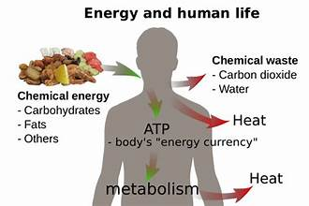
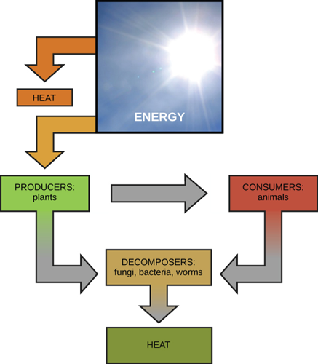
Laws of thermodynamics & The Human Body (Applications of laws of Thermodynamics)
All living systems need energy to function. It is obvious that Humans need food to live, but the reason for this is less obvious.
The idea that Humans need energy because they consume energy is, strictly speaking, incorrect. The body can work only from chemical energy.
Living organisms are also thermodynamic entities, in which thermal process are characterized by energy flows and fluxes both within the body, between the body and its environment
Whether we are sitting in an air-conditioned room or travelling in any vehicle, the application of thermodynamics is everywhere.
There are a few of these applications below:
Different types of vehicles such as planes, trucks and ships work on the basis of the 2nd law of thermodynamics.
The three modes of heat transfer work on the basis of thermodynamics. The heat transfer concepts are widely used in radiators, heaters and coolers.
Thermodynamics is involved in the study of different types of power plants such as nuclear power plants, thermal power plants.

Slide 10
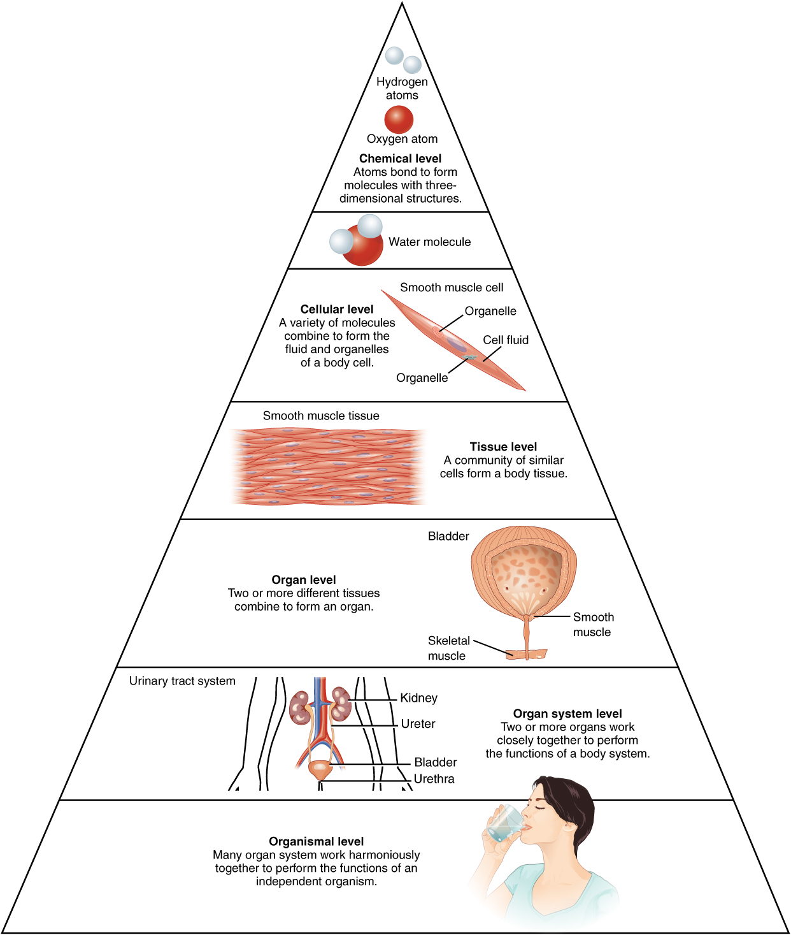
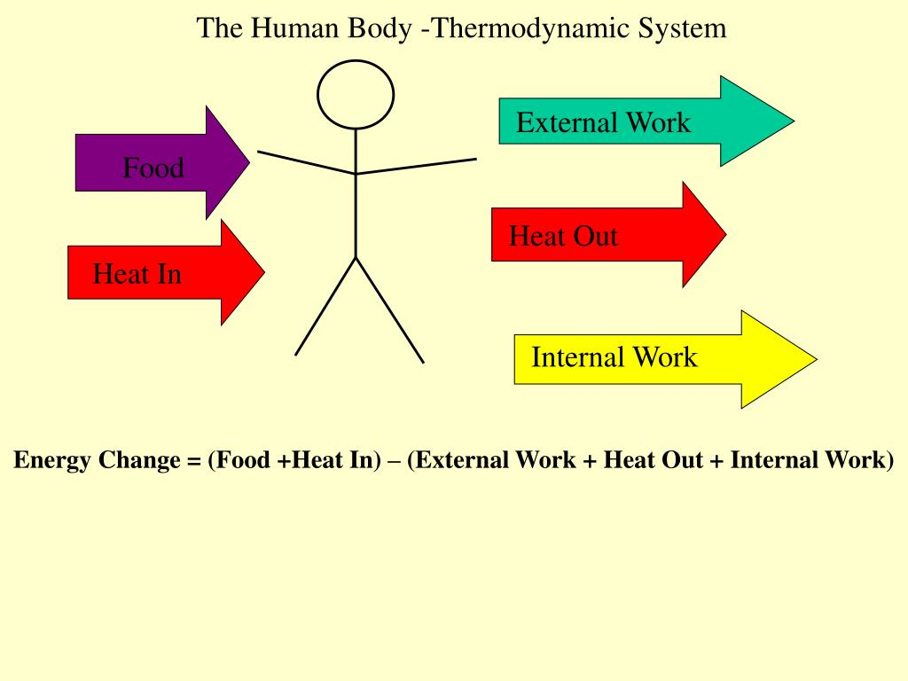
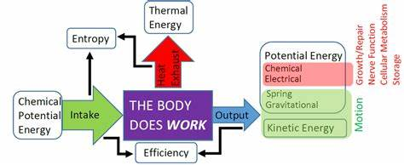
Does the human body obey the laws of thermodynamics?
Yes, the human body obeys the law of thermodynamics.
When you are in a crowded room with other people, you start to feel warm, and you start to sweat. This is the body’s way to cool itself.
The heat from the body is transferred to the sweat. As the sweat absorbs more heat, it evaporates from your body, becoming more disordered and transferring heat to the air, which heats the room’s air temperature.
Many sweating people in a crowded room, “closed system,” will quickly heat the place. This is both the first and second laws of thermodynamics in action.
No heat is lost; it is merely transferred and approaches equilibrium with maximum entropy.
The End

